Slide 1
Car Rental Management System
Presented by :
Gowrikumar.D

Slide 2
OVER VIEW
INTRODUCTION
OBJECTIVES
PROJECT SCOPE
USE CASE DIAGRAM
FUNCTIONAL REQUIREMENTS
CONCLUSION
THANK YOU

Slide 3
INTRODUCTION
This is a Java Project on Car Rental Management System, which provide a lot of facility to their business.
It will recorded the details of various activities of customers as well as information about booking.
It will simplify the task and the paper work.
Registration of Customer.

Slide 4
OBJECTIVES
The purpose of this Car Rental Management System project is to achieve customer satisfaction by car rental system.
The system helps the administration to maintain all details of the customer details, vehicle details, booking details.
The system should provide up to date accurate information

Slide 5
PROJECT SCOPE
The Scope of the software product developed involves paid service to the customers for rent a number of car that are being offered.
It involves a very simple registration procedure to be done by the admin or system.
Provide car for users as an alternative for them to select car if they want to chose car by their own.

Slide 6
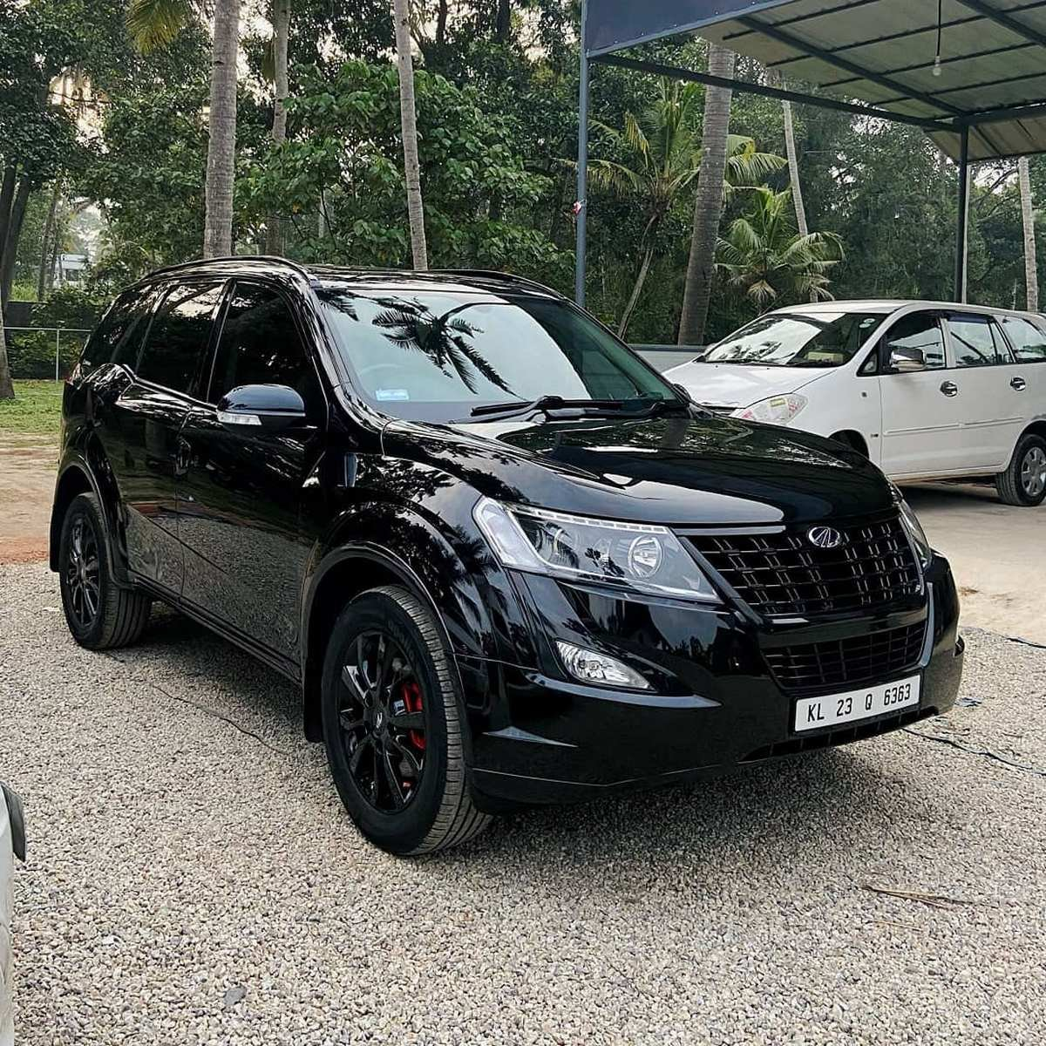
Use Case Diagram
Add Car
Display Car
Update Car
Delete Car
Availability Car
Search Car

Slide 7
FUNCTIONAL REQUIREMENTS
ADD CAR();
In this method we are adding the cars with parameters if id, make(brand), model, year, rental price. We generate unique id for every car.
DISPLAY CAR();
In this method we will display list all car details.
UPDATE CAR();
In this method we will modify rental price or availability states of specific car by using ID.
DELETE CAR();
In this method we will remove the using ID.
CHECK AVAILABILITY CAR();
Check whether the car is available or not by using id , name, model
SEARCHING CAR();
In this method we will searching the car id ,make , model

Slide 8
CONCLUSION
A special thanks to our mentor for the guidance and support which we have provided for the completion of our project.
We welcome your co-operation and feedback.
Our aim is to provide a very user-friendly customer registration system who want to take for rent.

Slide 9


